Slide 1
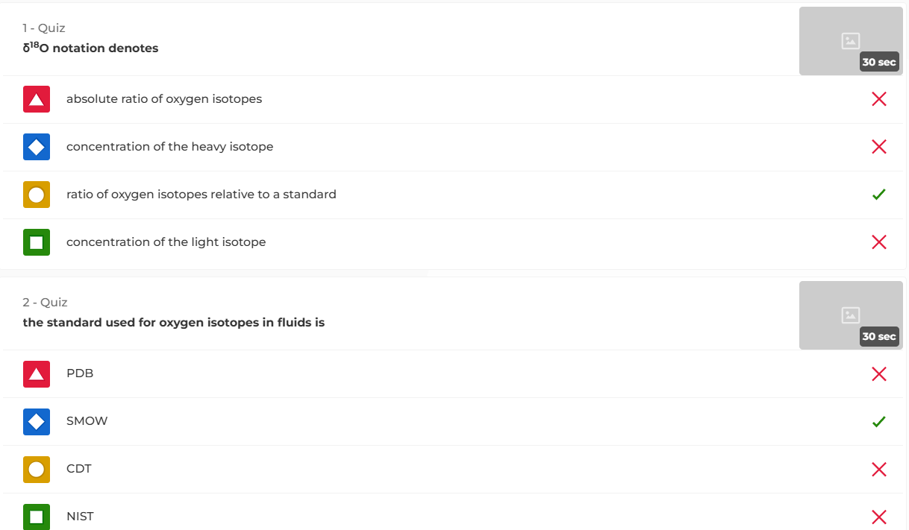

Slide 2
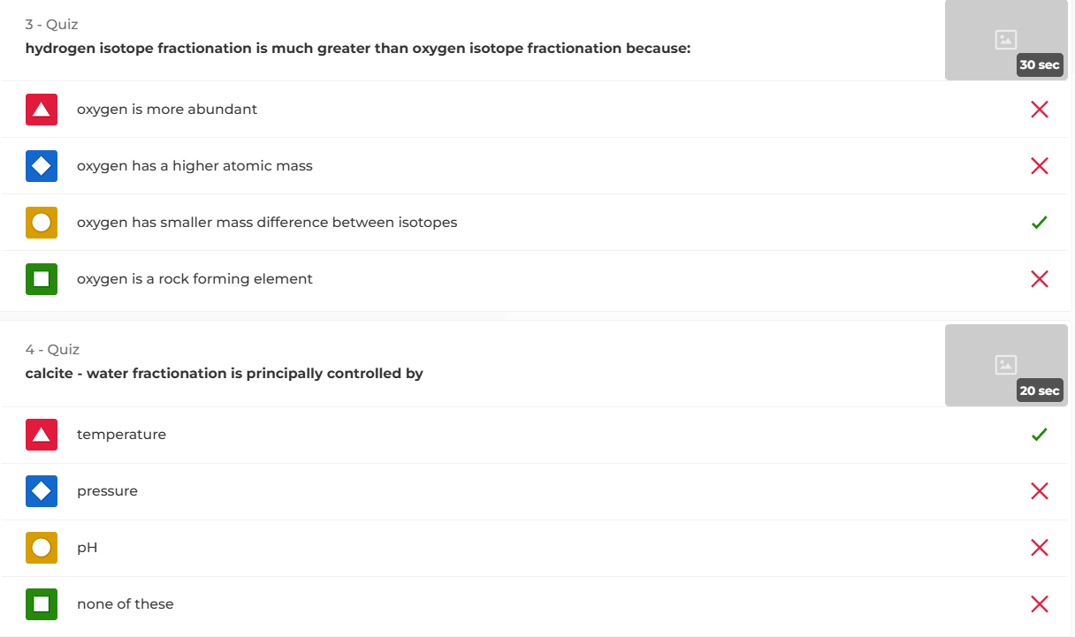

Slide 3
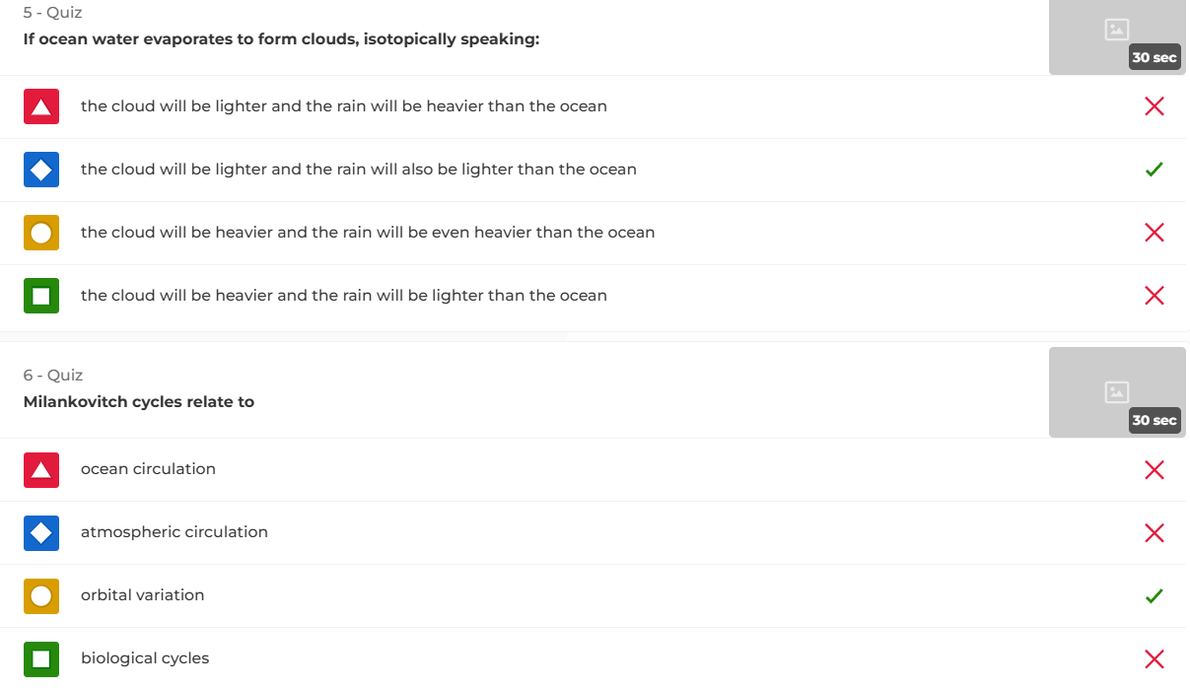

Slide 4
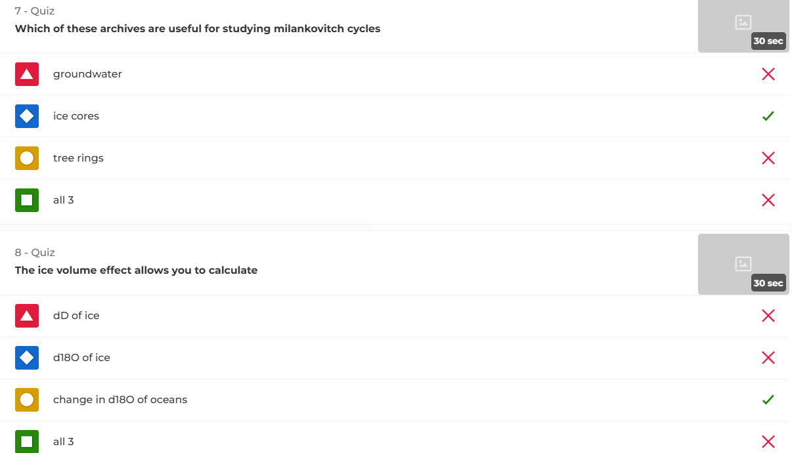
Bit of confusion in the lecture (by me!). It is ice cores only because the other 2 can be palaeoclimate archives but they don’t go back far enough in time to cover Milankovitch cycles

Slide 5
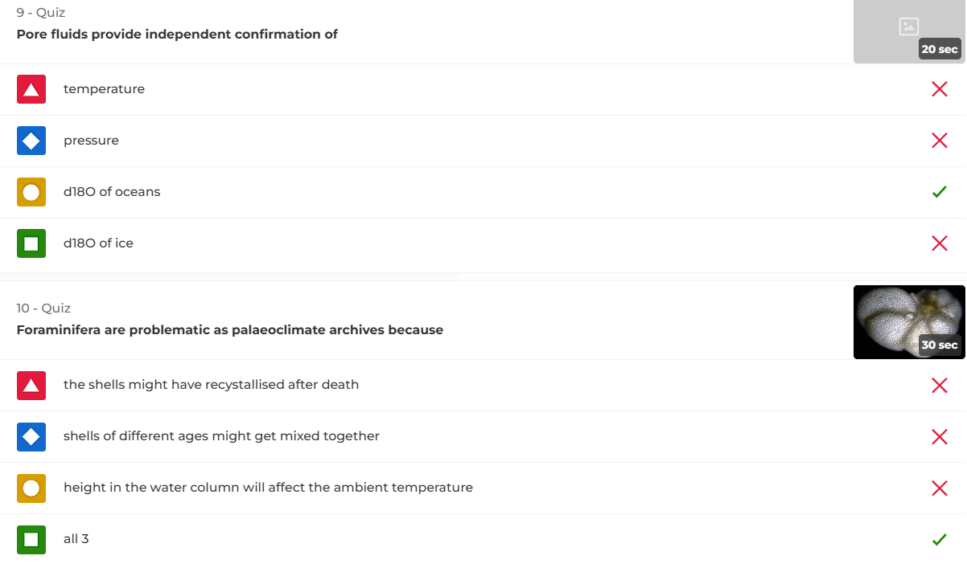

Slide 6
